Slide 1
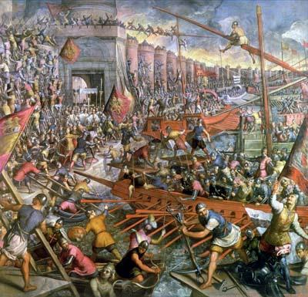
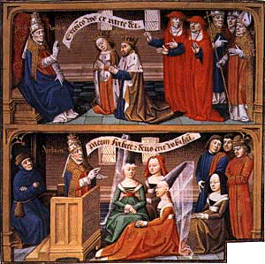
The Crusades and the Wider World High Middle Ages PPT #3
1050 – Western Europe emerging from period of isolation
India, China, Arab World and the Americas - all thriving civilizations with large cities
Byzantine Emperor asks Pope for help in fighting Muslims who were threatening Constantinople
1095 – Pope Urban calls bishops &nobles to action

Slide 2
Nobles, knights, peasants, even children, were called to “take up the cross” and fight for the “holy cause “
Motivation: To be forgiven for sins (for self and for dead relatives) and gain salvation/
To recapture the Holy Land / For excitement in exotic lands/ To get wealthy
Palestine – The Holy Land
The Holy Land: An ancient region of southwest Asia on the east coast of the Mediterranean
Reading: An Eyewitness Account of the First Crusade” / Play Game of the Crusades

Slide 3
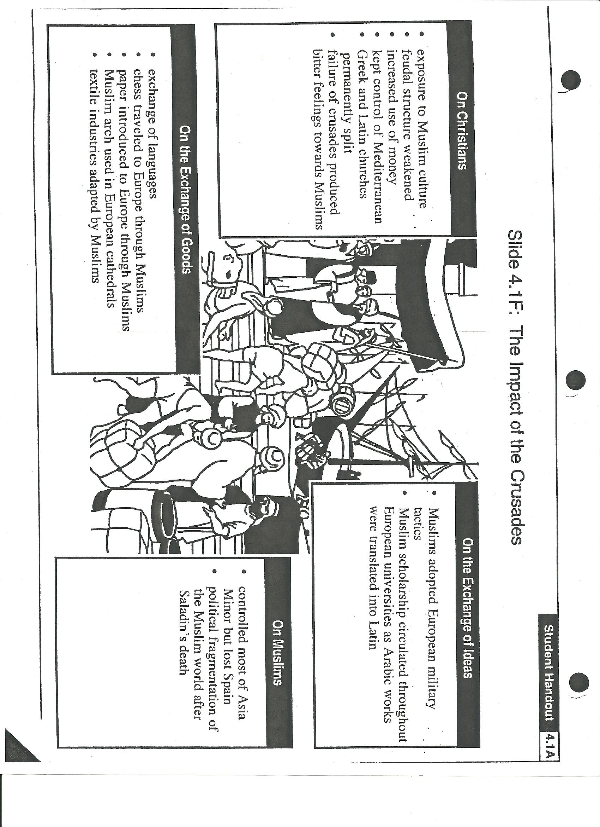
Failure of crusades left bitter feelings toward Muslims
Feudal structure weakened
Increased use of money
Kept control of Mediterranean
Greek and Latin churches permanently split
Decreased power of church, increased power of monarchs
Muslims developed bitterness & distrust of the Christian world
Muslims adopted European military tactics
Muslim scholarship circulated throughout European universities as Arabic works were translated into Latin
Controlled most of Asia Minor but eventually lost Spain in The Reconquista
Political fragmentation of Muslim world after Saladin’s death
Exchange of languages
brought back catapults, gunpowder, better medical knowledge, pointed arches, windmills, wheel barrows etc
new domesticated animals: donkeys, carrier pigeons, and faster horses. New imports: carpets, silk, cotton, citrus fruits, sugar and sweets.

Slide 4
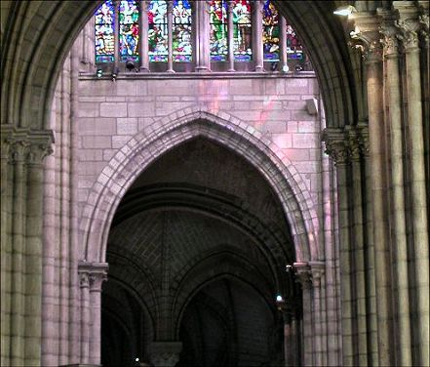
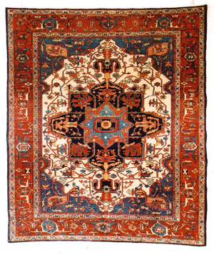
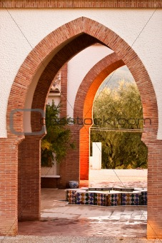
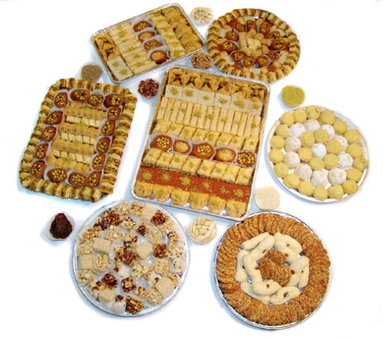
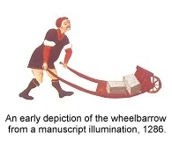
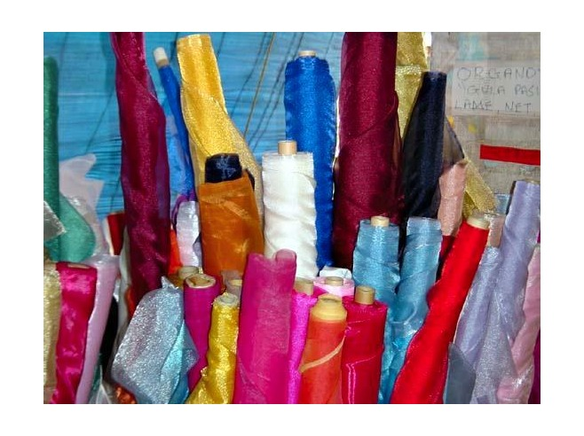
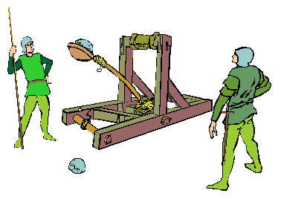
Once the Europeans had a taste for all of these items – they wanted more. This opens the door to the age of exploration.

Slide 5
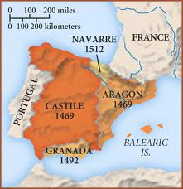
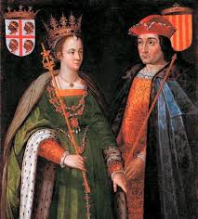
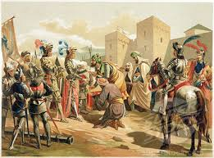
The Reconquista
Crusading spirit continued - especially in Iberian Peninsula (Spain & Portugal)
700s - Muslim Moors conquered most of Spain
Christian campaign to regain land in Spain = RECONQUISTA
1492 – Under Ferdinand & Isabella - final Muslim stronghold of Granada fell – Reconquista was complete

Slide 6
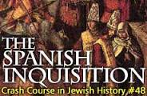
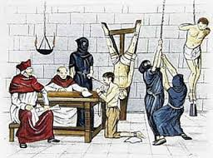
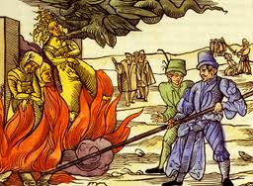
The Inquisition
Spain expels non-Christians
Previously, Christians, Jews & Muslims lived peacefully
Queen Isabella wanted political & religious unity
Church court set up to try people of heresy
If a Muslim or Jew would not convert or confess they were arrested – tortured – burned at stake
1492 – Spain expelled all Jews – many were skilled & educated – expulsion hurt economy & culture

